Slide 1
AMAZON SALES DATA ANALYSIS

Slide 2
Introduction
Sales management has gained importance to meet increasing competition and the need for improved methods of distribution to reduce cost and to increase profits. Sales management today is the most important function in a commercial and business enterprise.
Tool use: Excel and Power Bi

Slide 3

MAIN KPIs
1.Total Revenue
2.Total Quantity
3.Total Profit

Slide 4
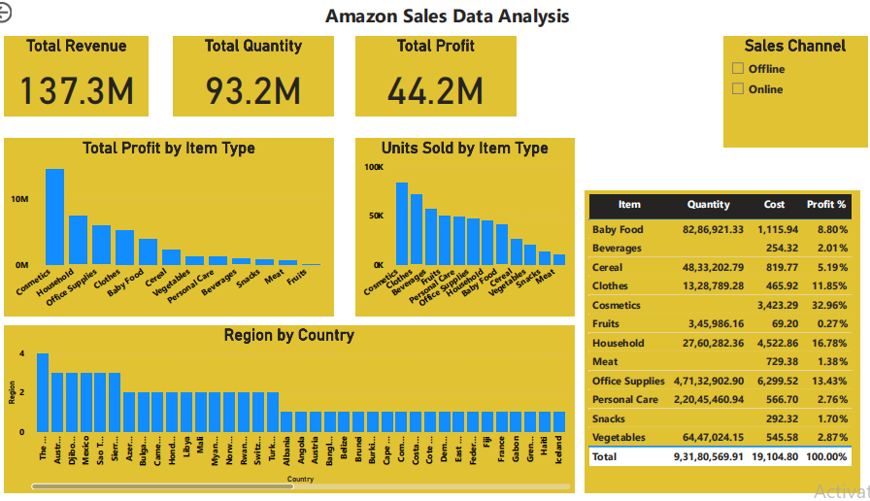
Final Dashborad

Slide 5
Thank You

